Slide 1
Table of contents
Week 9
Name of the lesson: The dream workplace
Lesson objectives:
To describe spaces and workplaces
To read two descriptions and understand the main idea
To watch a video and describe what is seen
To listen to an audio and contrast information from different sources

Slide 2
This lesson will be
recorded
Notes:
Remember that all lessons are recorded.

Slide 3
Week 9 – LEVEL 1
The dream workplace

Slide 4


Weekly plan
Part I
Part II
The dream workplace
Oral focus
Describe your dream workplace
Dream workplaces
Describing places
Language focus
Video about Samsung’s Headquarters
Listening comprehension
Notes:
Each weekly plan includes 2 classes. In the second class, the focus is written work only.

Slide 5

Today’s agenda
Talk about places where we work or study
Read people describing places
Watch a video about office amenities
Listen to a remote worker talk about his place.

Slide 6
Getting started

Slide 7
Dream
workplaces

Slide 8

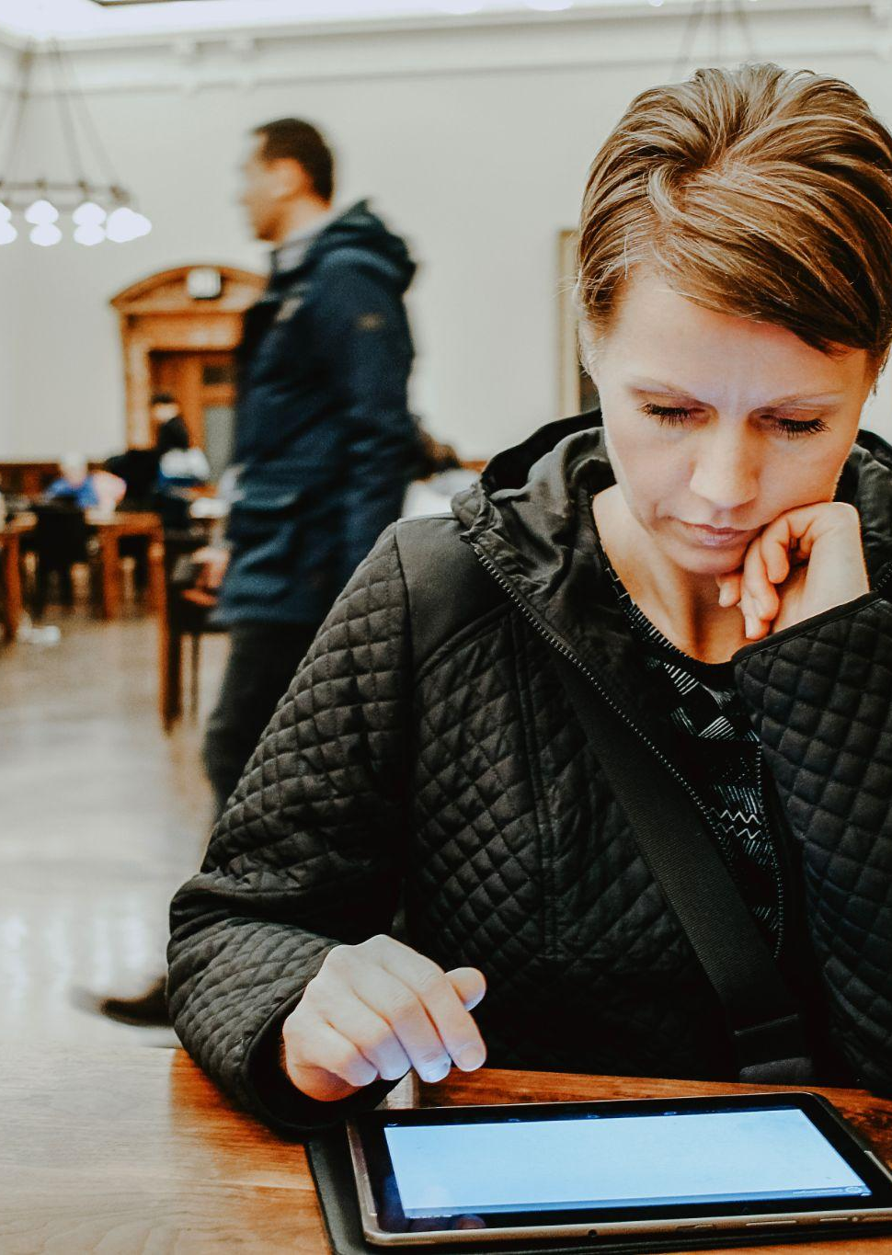

WHOLE CLASS DISCUSSION
Where do you study/work best?
Do you prefer public places like an office, a café, or a library to concentrate? Or do you prefer staying at home? What is important to you?
SILENCE/QUIETNESS
PUBLIC PLACES/NETWORKING
SHARING BREAKS WITH OTHERS
Raise your hand to share your ideas ESTIMATED TIME: 10 minutes
Notes:
T asks the question and clarifies meaning if necessary. The discussion can be carried in English or Spanish depending on the Ss levels. Ss raise their hands and open mic to answer their question. The idea is that Ss talk about how they concentrate better and what helps them organize their work/study day better. For some people, it is easier to go to an office or library, feel some pressure to stay focused because of the environment they are in, some other prefer staying at home. Some questions to keep the conversation flowing: what do you do during work/study breaks? Are you friends with your coworkers/classmates? Do you need silence to focus or can you work/study with music, noise and conversations in the background?

Slide 9


WHOLE CLASS WORK
READING COMPREHENSION
Let’s read Martin’s and Laura’s ideas about their jobs and their ideal workplaces.
Read the texts.
Choose the best answer for each question.
Answer using the chat Estimated time: 15 minutes
Notes:
Usar para las subsiguientes slides de Actividades en clase.

Slide 10

READING COMPREHENSION
Where do you work best?
https://elements.envato.com/es/open-office-space-policy-business-people-having-in-77TQDE6
Hi, My name is Laura. I’m a content creator, and I work writing articles and designing campaigns for a site about films and series.
I usually work best in cafés, because I can listen to other people and get ideas for my articles. My dream workplace is an open office where you can speak with your coworkers and share ideas. In my ideal office, there is a café with small tables to sit in groups and a barista making the best coffee.

Slide 11

READING COMPREHENSION
Where do you work best?
https://elements.envato.com/es/portrait-of-man-telephoning-with-smartphone-at-mod-SVC7PM5
Hi, there! My name is Martín, and I’m a software developer. I work for a video games company.
I focus better working from home. After the lockdown, the company let us stay working from home and for me, it is the best option! In my house there is a big desk with enough space for me to work comfortably. I also love cooking, so I spend a lot of time in the kitchen during my lunch break. My dream workplace is obviously my home!

Slide 12
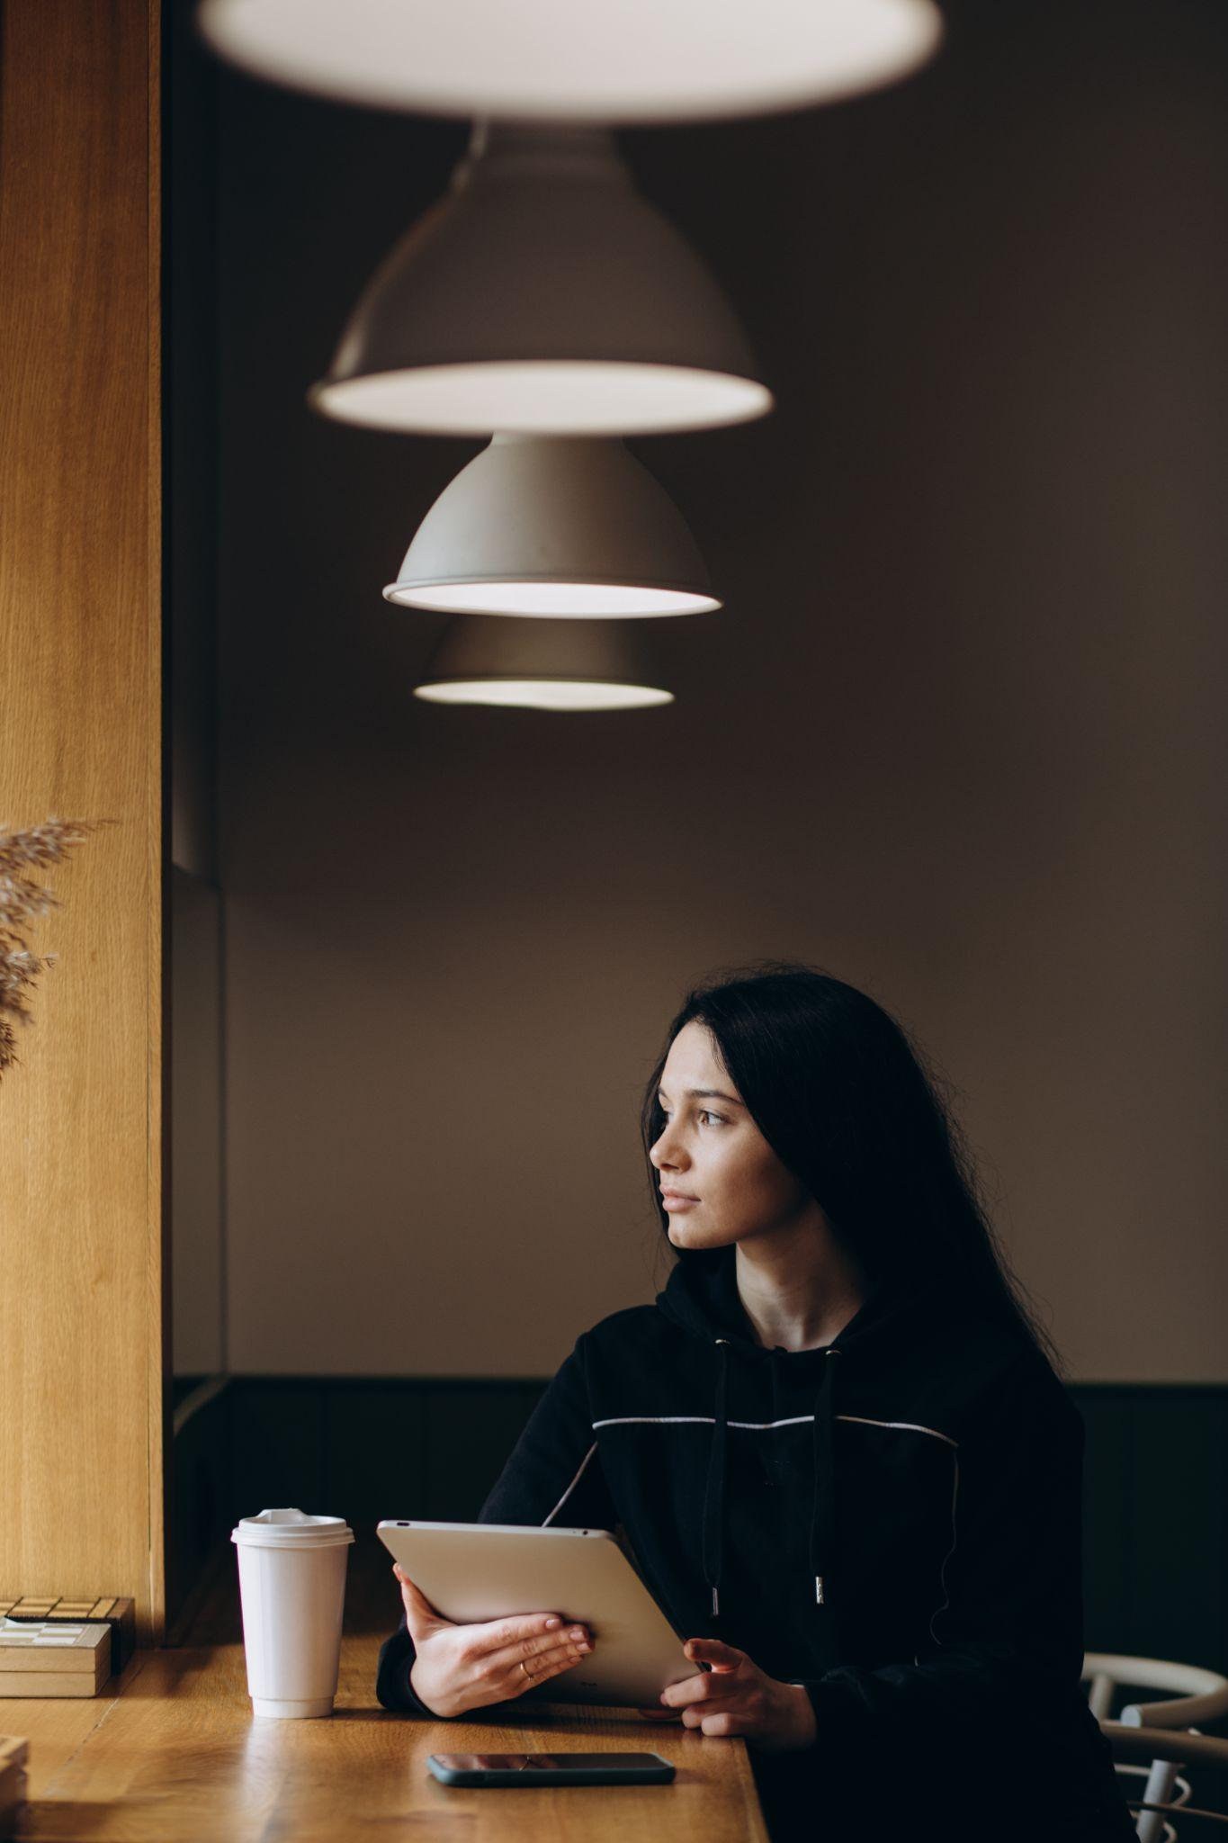
WHOLE CLASS ACTIVITY
READING COMPREHENSION
https://elements.envato.com/es/business-woman-sit-on-cafe-working-on-laptop-conce-7S3JZBL
Who prefers working with others?
a. Laura b. Martín
Who prefers the comfort of their home?
a. Laura b. Martín
Notes:
Answer:
1- Laura
2- Martín

Slide 13
WHOLE CLASS ACTIVITY
READING COMPREHENSION
https://elements.envato.com/es/business-woman-sit-on-cafe-working-on-laptop-conce-7S3JZBL
“There is a café with small tables to sit in groups and a barista making the best coffee.”
Who described this dream workplace?
a. Laura b. Martín
Notes:
Answer:
1- Laura
2- Martín

Slide 14
Language
focus

Slide 15

LANGUAGE FOCUS
Describing places
We use “there is” (singular) and “there are” (plural) to describe what exists or is in a place. For example:
In my dream workplace, there is a big resting area.
In my dream workplace, there are arcade games.

Slide 16
LANGUAGE FOCUS
Describing places
We use “there isn’t” (singular) and “there aren’t” (plural) for the negative. For example:
In my ideal workplace, there isn’t too much noise.
There aren’t uncomfortable desks or chairs.

Slide 17
LANGUAGE FOCUS
Describing places
Look at this picture of an open office.
Choose the best option.
Then, provide two more descriptions using the chat.
ANSWER USING THE CHAT ESTIMATED TIME: 10 minutes
Notes:
(Picture displayed bigger in next slide) Ss take around 3 minutes to look at the picture carefully, revise their notes and knowledge from previous classes and get ready to answer the questions in the next slides. After that, ask Ss to provide 2 more sentences using the chat, and the rest of the class should say if they are OK.

Slide 18

https://elements.envato.com/es/open-office-space-policy-business-people-having-in-77TQDE6
Notes:
Usar para slides de imagen completa.

Slide 19
WHOLE CLASS ACTIVITY
Describing places
_________ ergonomic chairs.
a. There is b. There are
_______ two monitors for each worker.
a. There aren’t b. There are
Notes:
Ask Ss to type A or B for what they consider the correct option. After checking, ask a Ss to read the complete sentence out loud.
Answers: 1B and 2A

Slide 20
WHOLE CLASS ACTIVITY
Describing places
_________ a kitchen.
a. There is b. There isn’t
_______ a separate office behind a glass window.
a. There is b. There are
Notes:
Ask Ss to type A or B for what they consider the correct option. After checking, ask a Ss to read the complete sentence out loud.
Answers: 1B and 2A

Slide 21

Break-time
We’ll be back in 10 minutes!

Slide 22
Video watching:
Samsung’s Headquarters

Slide 23
WATCHING A VIDEO
Inside Samsung’s office
We are going to watch a video about Samsung’s Headquarters in Silicon Valley.
Before watching: what do you know about Silicon Valley?
Silicon Valley is a region in San Francisco Bay, California, United States. It is a global technology and innovation hub, and a lot of tech companies have their headquarters there.
The name "Silicon Valley" comes from the material silicon, a component in the production of semiconductors, a crucial technology in electronics and computing.
https://elements.envato.com/es/silicon-valley-F8G2M9V
ESTIMATED TIME: 5 minutes
Notes:
Ss are asked to raise hand and answer using orally in English or Spanish.

Slide 24
WATCHING A VIDEO
Inside Samsung’s office
How do you imagine Samsung’s headquarters in Silicon Valley?
Predict the amenities workers can enjoy using “there is” and “there are”. Check your predictions watching the video.
https://elements.envato.com/es/silicon-valley-F8G2M9V
Amenities: features and services that add value and comfort to a location
ANSWER USING THE CHAT ESTIMATED TIME: 5 minutes

Slide 25
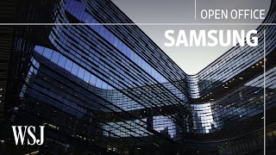
Inside Samsung's Futuristic $300 Million Office
https://youtu.be/BvngUP0sHhQ?t=220
Source: YouTube
Notes:
Play from 3.40 to the end (6.47).

Slide 26
WATCHING A VIDEO
Inside Samsung’s office
True or false?
There are a lot of open spaces in different floors
There are 2 cafés inside the main building
There is a colorful cafeteria
There are square tables in the cafeteria
TRUE
FALSE
FALSE
FALSE
ANSWER USING THE CHAT ESTIMATED TIME: 5 minutes
Notes:
Ask Ss to provide the correct version of each false sentence using the chat.
There is a cafeteria outside the main building. There is a coffee shop on campus.
There is a black and white cafeteria. The cafeteria isn’t colorful.
There are small, round tables, and big, rectangular tables in the background.
There

Slide 27
Listening
focus

Slide 28
WHOLE CLASS DISCUSSION
Is Silicon Valley everybody’s dream?
What are the benefits of working in Silicon Valley? What are the disadvantages? Do all people want the same from their jobs? What alternatives can you think of?
Raise your hand and give your opinion orally Estimated time: 5 minutes
Notes:
Ss are asked to reflect on these questions. Discussion can be carried in English or Spanish, depending on the group.

Slide 29

WHOLE CLASS DISCUSSION
Silicon Valley is not my dream
Listen to this remote worker.
Describe the places there are in his town.
Why isn’t Silicon Valley his dream?
Raise your hand and answer orally Estimated time: 10 minutes
Notes:
Script: Hi! This is Paul. I’m a software developer and I work from home for an international company. I love staying home and not having to go to the office early in the morning. I live in a beautiful neighborhood in a small town, and I enjoy my life here. There is a park 10 minutes away from home where I train every morning. When it rains, or it is too cold, I train in my home’s garage. There is a bar near my house, I go there to meet my friends every Thursday. They also work from home, so we have similar routines. There aren’t a lot of restaurants in my town, but that isn’t a problem, I just cook, and I save a lot of money. Those dream offices in Silicon Valley are not my dream, I love my remote job.

Slide 30
Oral focus

Slide 31

Oral focus lab
We will carry out different class activities to understand and put into practice the theoretical concepts we have seen.
In what way?
First, we will make a collaborative brainstorming to revise together some theoretical concepts. Then, you will work individually, and give a final revision to your work. When you are done, you will present your work and receive feedback. Finally, we will work collaboratively, sharing progress and asking questions.
Estimated time: 80 minutes + 10-minute break

Slide 32
MY DREAM WORKPLACE
Describe your dream workplace. Use there is/there are and the vocabulary from this class to describe the amenities and the environment.
You can google some pictures for inspiration. Be ready to share your ideas with the rest of the class.
Notes:
Anticipate the task for class 6 (oral focus)

Slide 33
Break-time
We’ll be back in 10 minutes!

Slide 34
Step by step
1
2
3
Step 1
Step 2
Step 3
Revise collaboratively
and work individually
Estimated time: 20 minutes
Share work and
receive feedback.
Estimated time: 40 minutes
Share progress
and ask questions.
Estimated time: 20 minutes

Slide 35

Let’s get started!

Slide 36
Step 1
Collaborative revision and individual work
Estimated time: 20 minutes

Slide 37
STEP 1 - PART I
Collaborative revision
Description of the activity.
We’ll revise together the theoretical material we saw last class.
Useful structures & vocabulary to describe dream workplaces.
Estimated time: 10 minutes
Notes:
Usar para las subsiguientes slides de Actividades en clase.

Slide 38
LANGUAGE FOCUS
Describing places
We use “there is” (singular) and “there are” (plural) to describe what exists or is in a place. For example:
In my dream workplace, there is a big resting area.
In my dream workplace, there are arcade games.

Slide 39
LANGUAGE FOCUS
Describing places
We use “there isn’t” (singular) and “there aren’t” (plural) for the negative. For example:
In my ideal workplace, there isn’t too much noise.
There aren’t uncomfortable desks or chairs.

Slide 40
Let’s revise these topics!
silent/noisy places
being alone/with others
How do you spend breaks?
Workplace amenities
Places in your town/city
Notes:
For more competent students T will expand on each of these. Some Ss can be allowed to share briefly some experience on one of the topics.

Slide 41
STEP 1 - PART II
Individual work
Description of the activity.
Use this time before the break to complete your work individually and get ready for your oral presentations.
Estimated time: 10 minutes
Notes:
Usar para las subsiguientes slides de Actividades en clase.

Slide 42
Step 2
Share your work and
receive feedback.
Estimated time: 40 minutes

Slide 43
MY DREAM WORKPLACE
Describe your dream workplace. Use there is/there are and the vocabulary from this class to describe the amenities and the environment.
You can google some pictures for inspiration. Be ready to share your ideas with the rest of the class.
Notes:
Anticipate the task for class 6 (oral focus)

Slide 44
COLLABORATIVE ACTIVITY
Commitments
Attendance
Have an active participation in class, avoid distractions.
Active listening
Listen and process what others express in the class.
Attitude to learning
Be ready to keep learning at every moment. Sharing is welcome, collaborative work prevails.
Respect
Listen to each other, we can all express what we think. Let everybody participate. .

Slide 45

STEP 2 - PART II
Whole class
Sharing our work
Let’s share your work with the class!
Use this part of the class to share your work with the rest of the class and receive feedback from peers and teacher.
Estimated time: 25 minutes
Notes:
Usar para las subsiguientes slides de Actividades en clase.

Slide 46
Step 3
Share progress and
ask questions.
Estimated time: 25 minutes

Slide 47
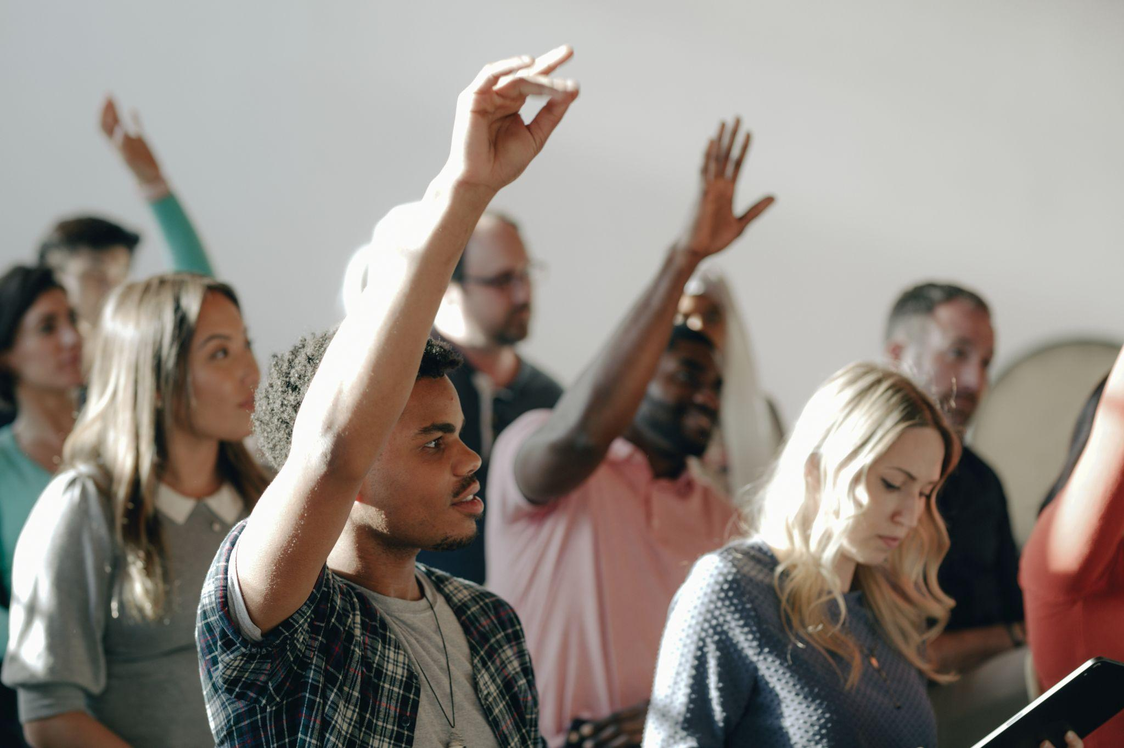
STEP 3
Let’s clear your doubts!
Let’s do some revision
Firstly, think individually about any questions you may have. You can think about your own work or the work of others you have listened to.
Afterward, ask your questions orally or type them in the chat.
Estimated time: 25 minutes
Notes:
Usar para las subsiguientes slides de Actividades en clase.

Slide 48
Any questions?

Slide 49
Today’s agenda - checkout
We talked about places where we work or study
We read people describing places
We watched a video about office amenities
We listened to a remote worker talk about his place.

Slide 50
See you next class!

